Slide 1
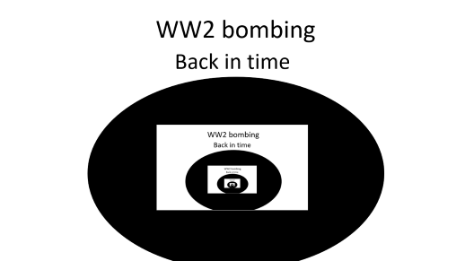

WW2 bombing
Back in time

Slide 2
“Get in the shelter!” someone screamed over the ear pitchy siren I could
Barely hear My mum and sister . I felt my foot get stuck (under the Rubel that
Just fallen). My friend Timber had stood on a land-mite I heard him scream in shock . I scramble of to go help . “Timber” I scream! I see him birred two meters away from me . As I get myself free I check if he is alive. Relieved I say “you scared me” as I wipe the sweat of my head . I drag him to his Anderson shelter
I hear a scream my brother . I run as fast as I can . I fall to my knees he’s gone. I feel a tear run down my faces .

Slide 3
It was a silant m

